Slide 1
Halloween Quiz Game!

Slide 2
Characters
Activities
Animals
Monsters
Places
Food
$100
$100
$100
$100
$100
$100
$200
$200
$200
$200
$200
$200
$300
$300
$300
$300
$300
$300
$400
$400
$400
$400
$400
$400
$500
$500
$500
$500
$500
$500
$600
$600
$600
$600
$600
$600

Slide 3
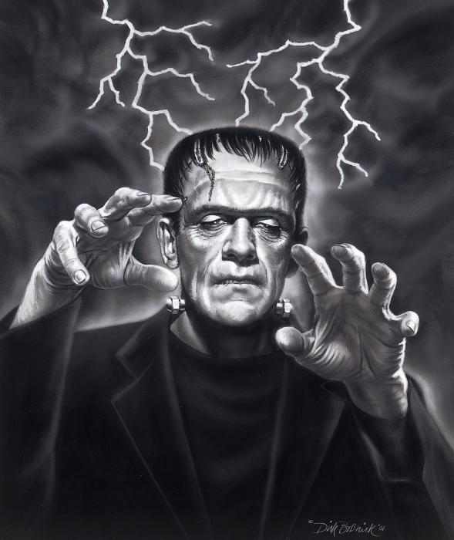
$100
What is this character called?
Batman
Frankenstein
Dracula
Naoya-Sensei

Slide 4
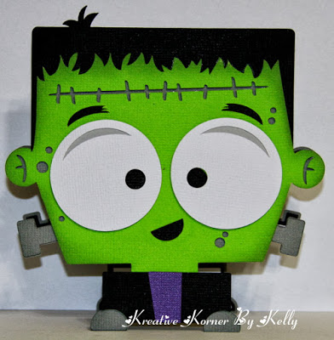
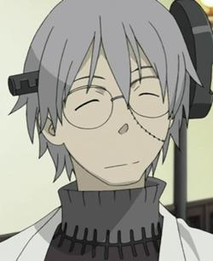
It`s Frankenstein!

Slide 5
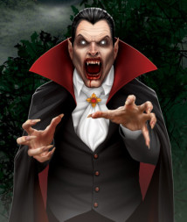
$200
What is this character called?
Dracula
Frankenstein
Spiderman
Werewolf

Slide 6
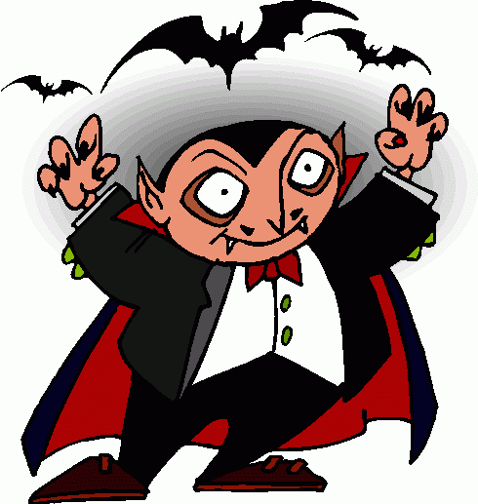
It`s Dracula!

Slide 7
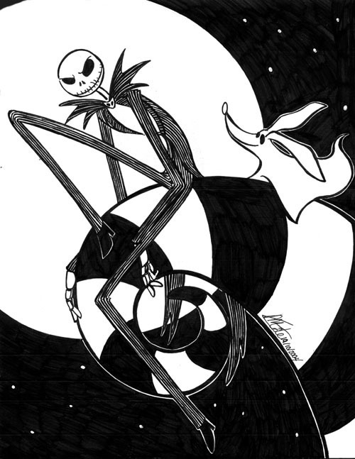
$300
What is this character called?
Joe
Dracula
Jack Skellington
Frankenstein

Slide 8
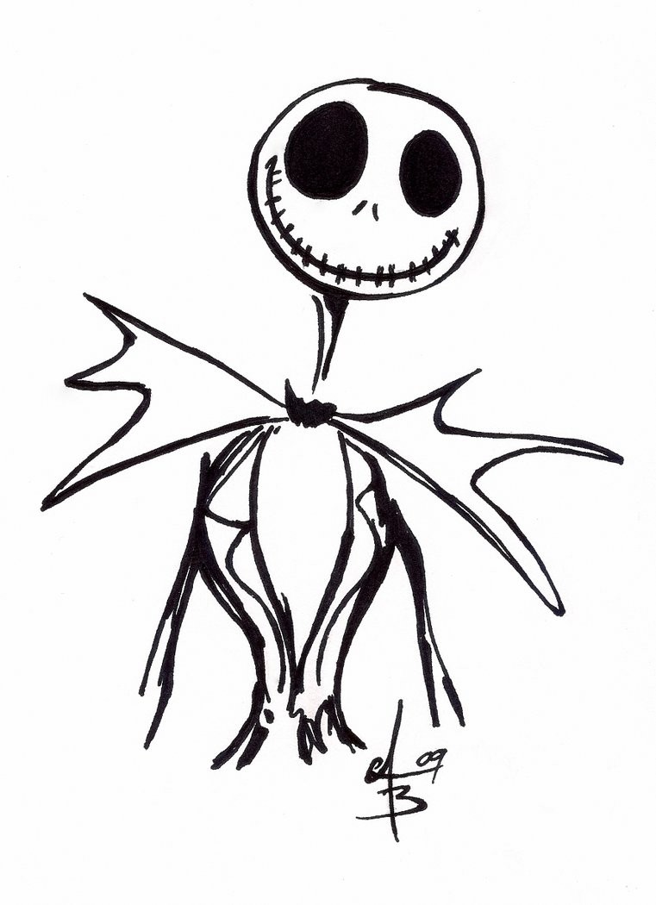
It`s Jack Skellington!

Slide 9
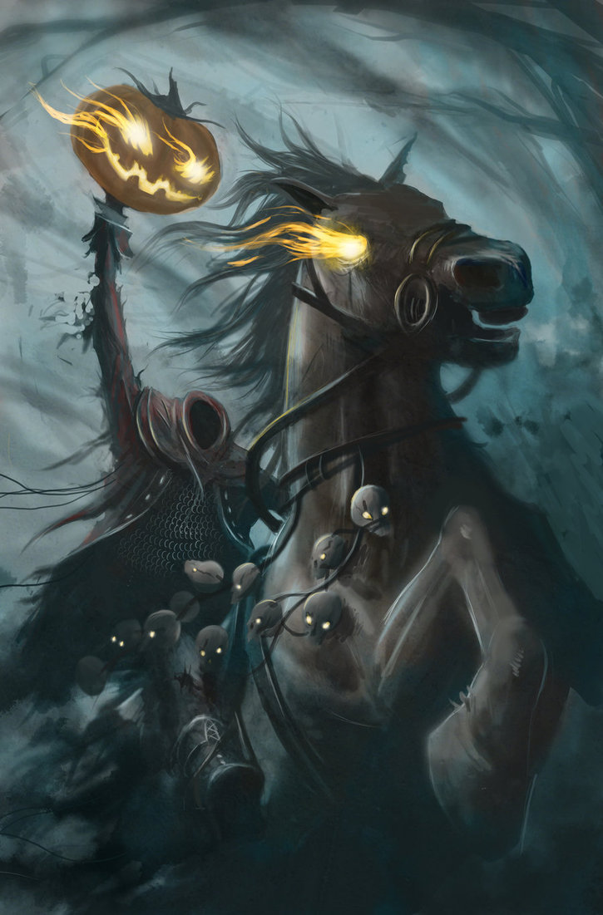
$400
What is this character called?
Date Masamune
Frankenstein
Skeleton King
The Headless Horseman

Slide 10
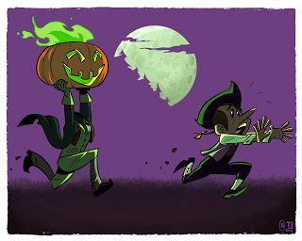
It`s The Headless Horseman!

Slide 11
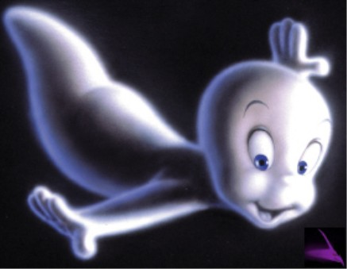
$500
What is this character called?
Dracula
Totoro
Casper
Monkey D. Luffy

Slide 12
It`s Casper, the Friendly Ghost!

Slide 13
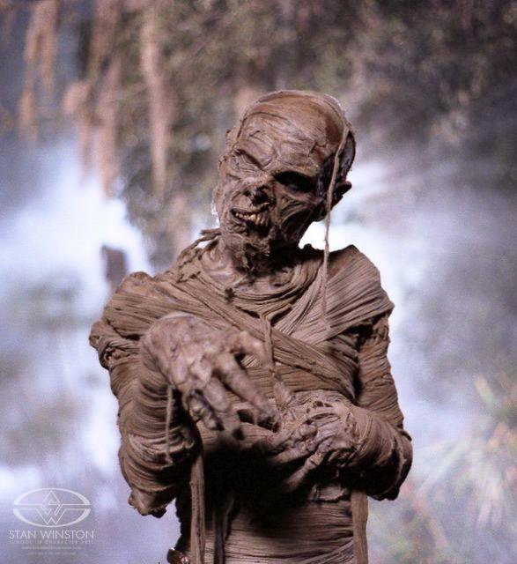
$600
What is this character called?
The Zombie
The Mummy
Batman
The Dead Guy

Slide 14
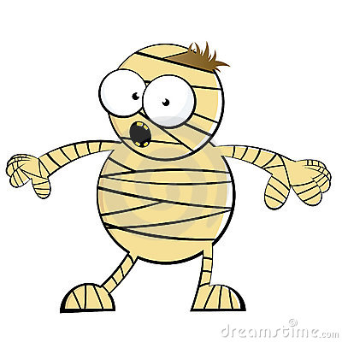
It`s The Mummy!

Slide 15
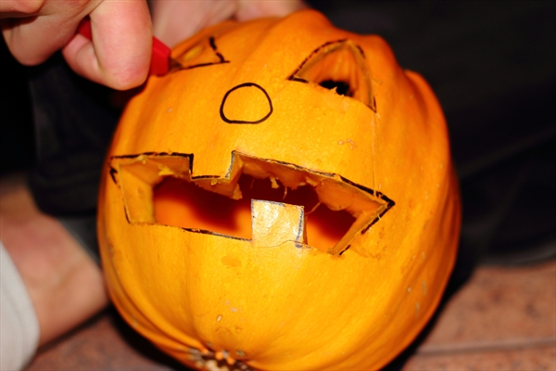
$100
What is this activity called?
Making pies
Making candy
Making Jack-O-Lanterns
Making Pumpkins

Slide 16
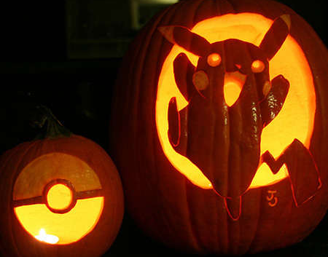
It`s “making Jack-O-Lanterns”!

Slide 17
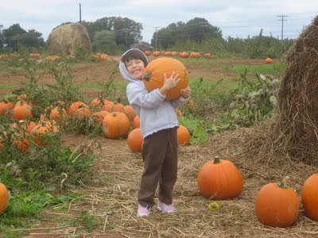
$200
What is this activity called?
Making pumpkins
Pumpkin Picking
Making Jack-O-Lanterns
Apple Picking

Slide 18
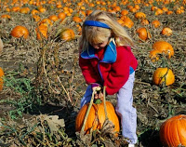
It`s “Pumpkin Picking”!

Slide 19
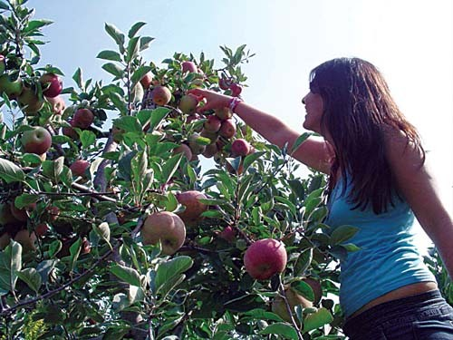
$300
What is this activity called?
Making apples
Apple Picking
Peach Hunting
Cooking apples

Slide 20
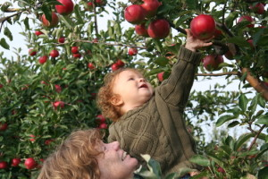
It`s “Apple Picking”!

Slide 21
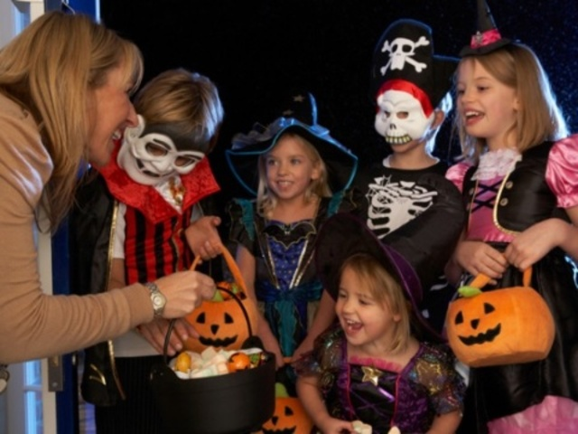
$400
What is this activity called?
Dancing
Candy stealing
Trick-or-Treating
Making Pies

Slide 22
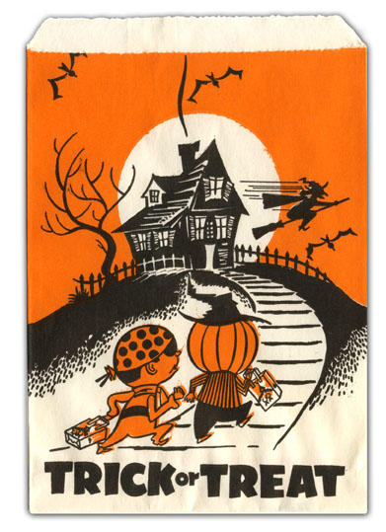
It`s “Trick-or-Treating”!

Slide 23
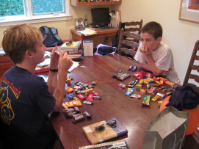
$500
What is this activity called?
Trading Candy
Trick-or-Treating
Making Pies
Robbing houses

Slide 24
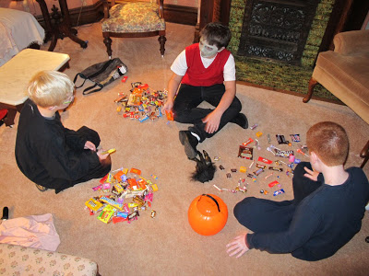
It`s “trading candy”!

Slide 25
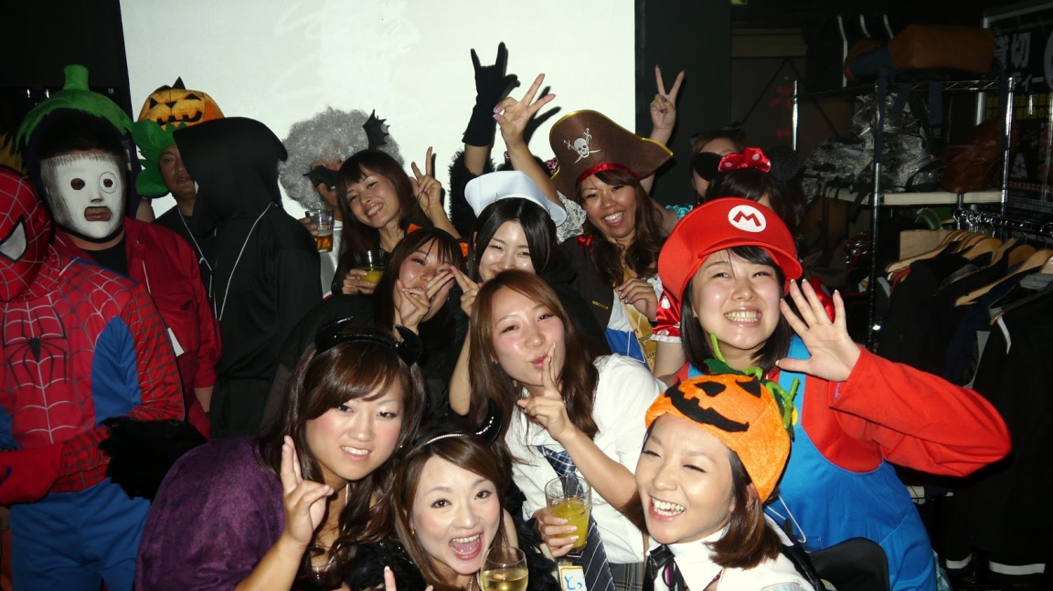
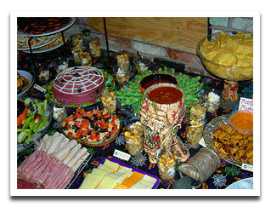
$600
What is this activity called?
Eating Cake
Going to a Halloween Party
Watching a movie
Apple Picking

Slide 26
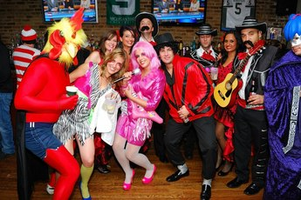
It`s “going to a Halloween Party”!

Slide 27
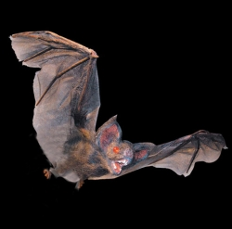
$100
What is this animal called?
Dog
Cat
Monkey
Bat

Slide 28
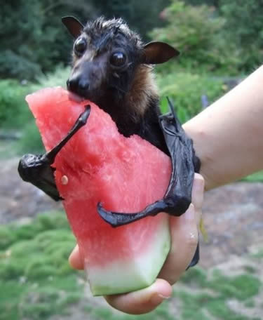
It`s a bat!

Slide 29
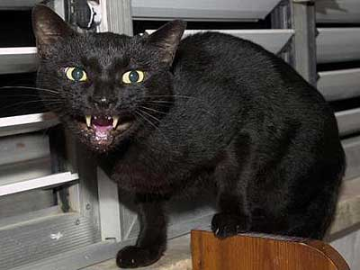
$200
What is this animal called?
Elephant
Tiger
Black Cat
Polar Bear

Slide 30
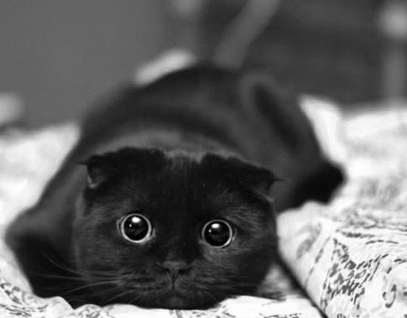
It`s a Black Cat!

Slide 31
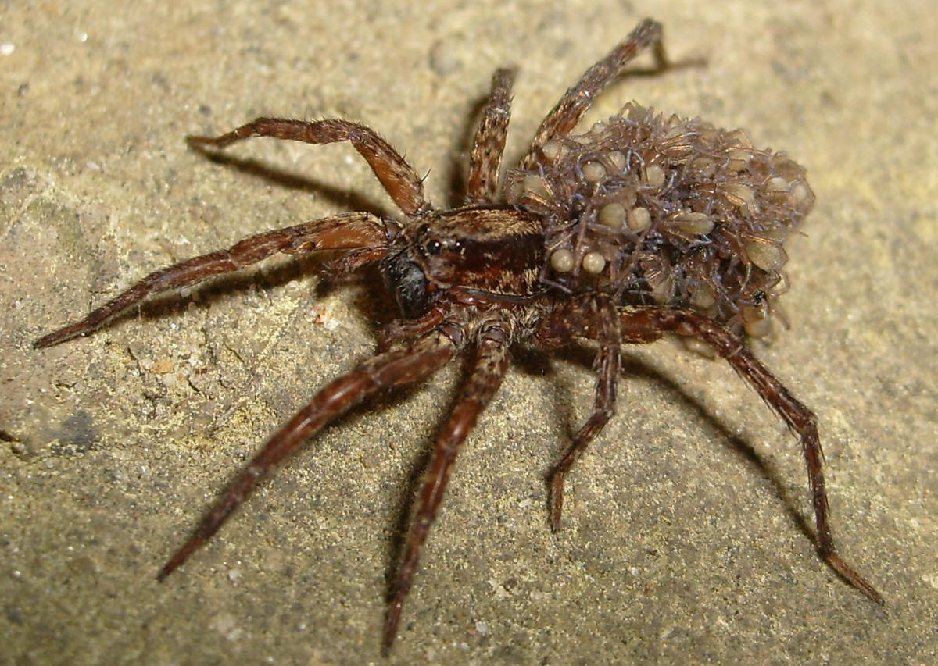
$300
What is this animal called?
Mosquito
Cheetah
Fly
Spider

Slide 32
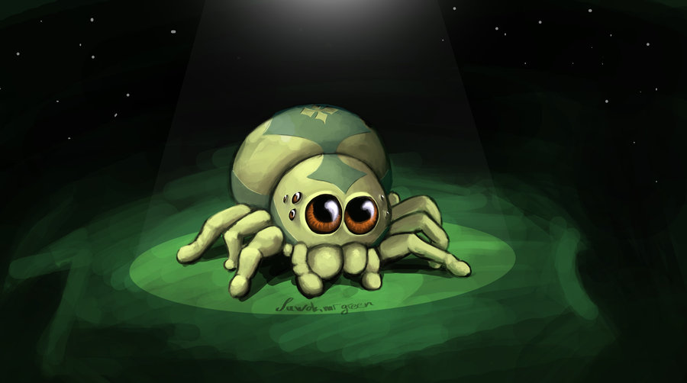
It`s a spider!

Slide 33
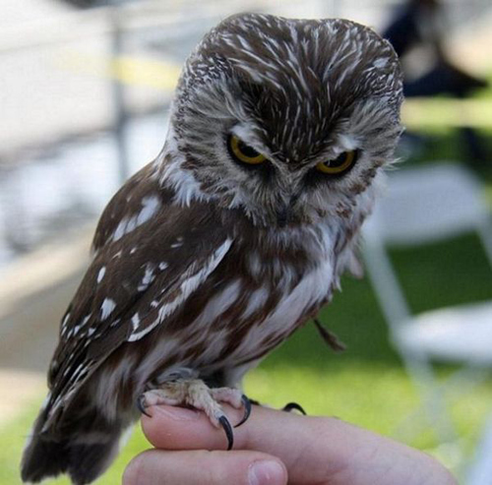
$400
What is this animal called?
Owl
Monkey
Crow
Frog

Slide 34
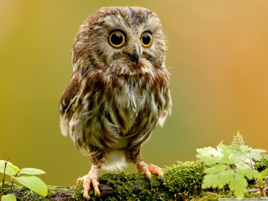
It`s an owl!

Slide 35
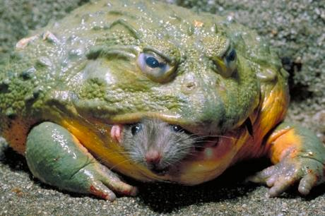
$500
What is this animal called?
Cat
Lizard
Monkey
Frog

Slide 36
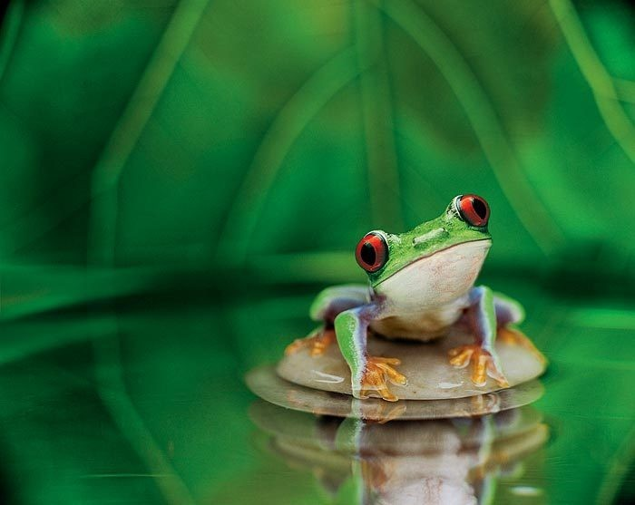
It`s a frog!

Slide 37
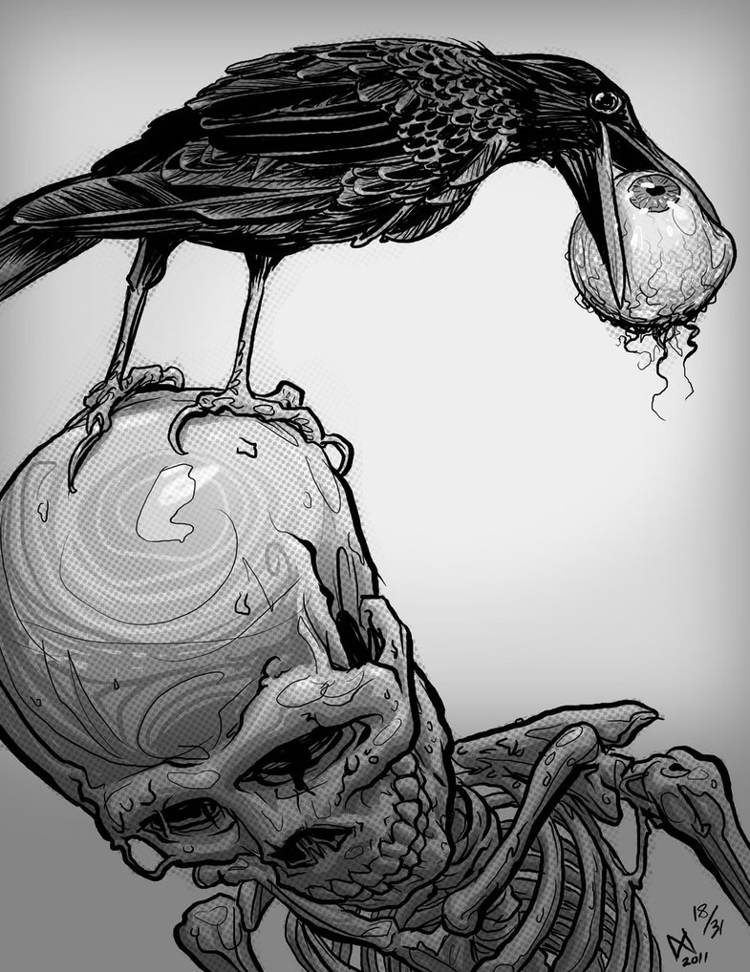
$600
What is this animal called?
Fish
Crow
Banana
Dog

Slide 38
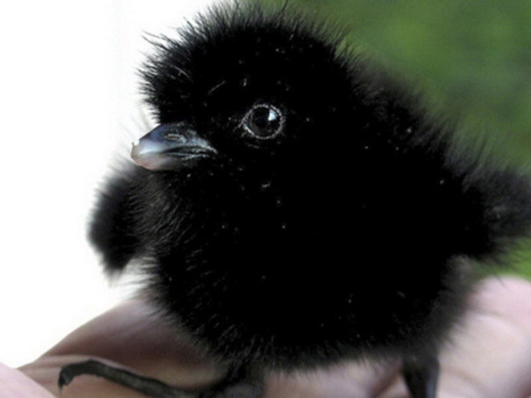
It`s a crow!

Slide 39
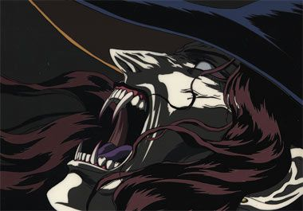
$100
What is this monster called?
Werewolf
Vampire
Jon-Sensei
Lady Gaga

Slide 40
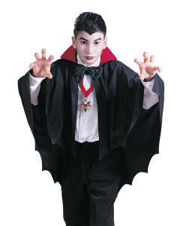
It`s a vampire!
Rar!

Slide 41
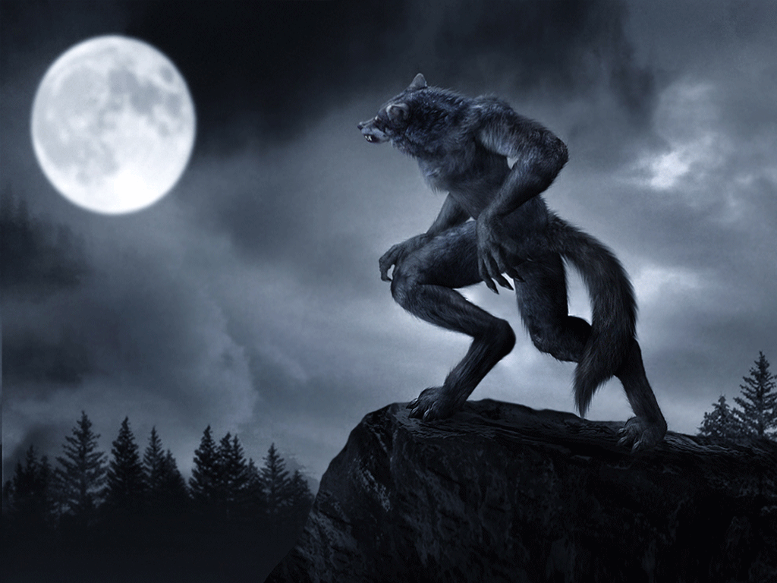
$200
What is this monster called?
Bat
Goblin
Dogman
Werewolf

Slide 42
It`s a werewolf!

Slide 43
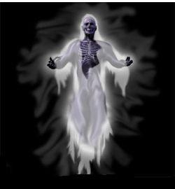
$300
What is this monster called?
AKB 48
Ghost
Zombie
Vampire

Slide 44
It`s a ghost!

Slide 45
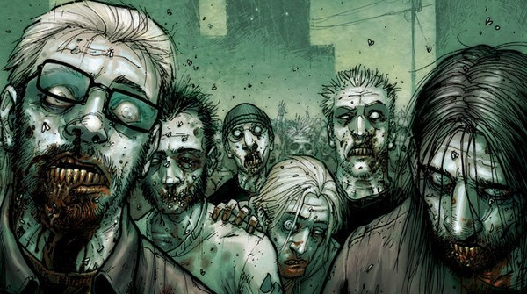
$400
What are these monsters called?
Ghosts
People
Zombies
Vampires

Slide 46
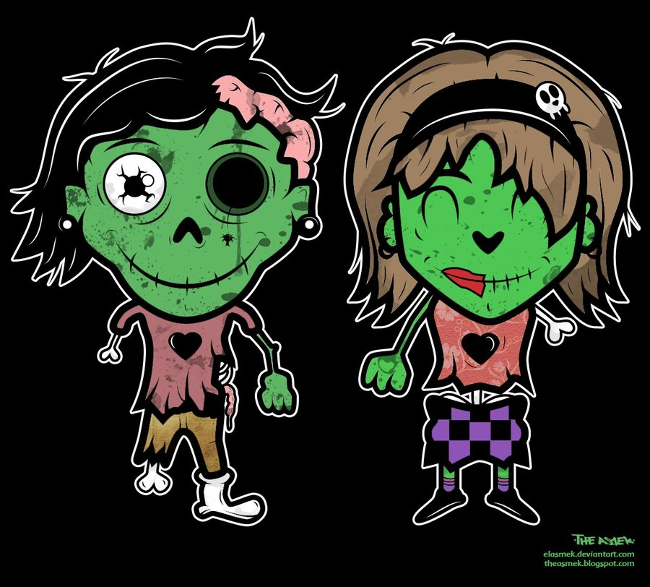
They are zombies!

Slide 47
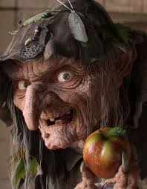
$500
What is this monster called?
Obaachan
Vampire
Gorilla
Witch

Slide 48
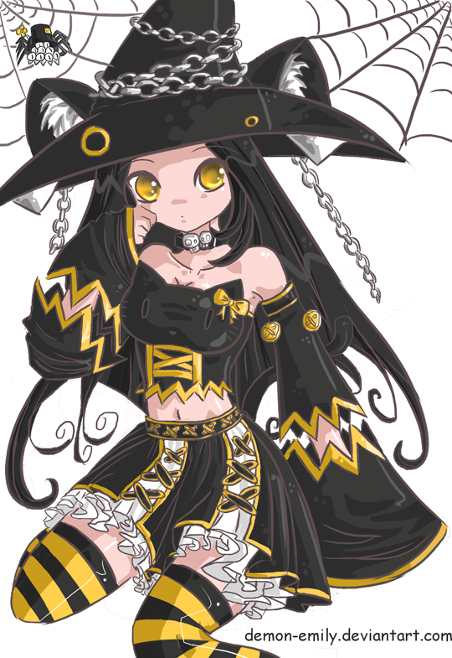
It`s a witch!

Slide 49
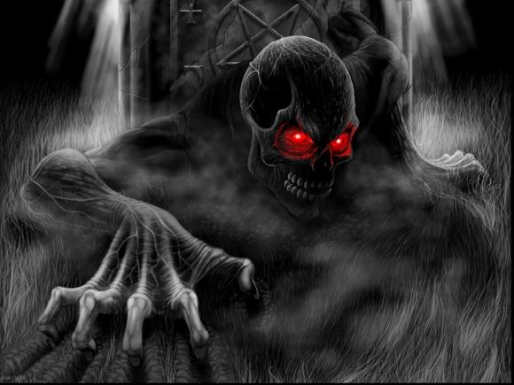
$600
What is this monster called?
Gorilla
Skeleton
Ojiisan
Werewolf

Slide 50
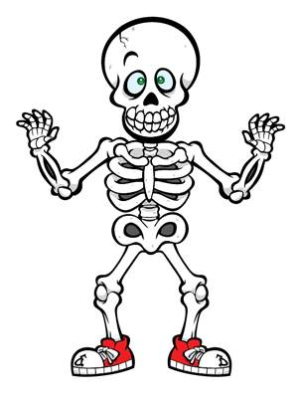
It`s a skeleton!

Slide 51
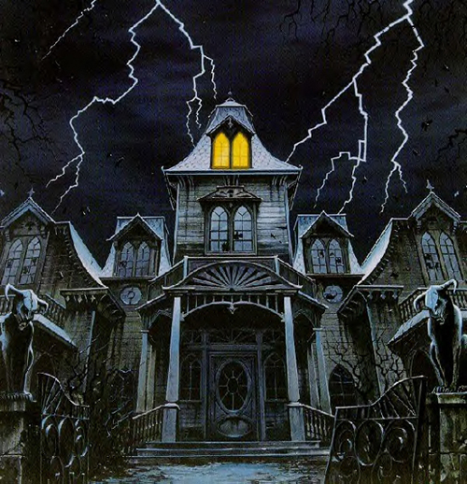
$100
What is this place called?
Africa
Haunted House
School
Mansion

Slide 52
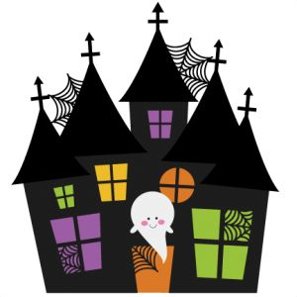
It`s a Haunted House!

Slide 53
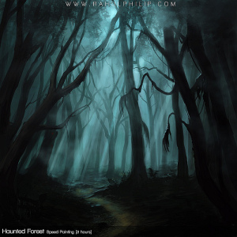
$200
What is this place called?
The woods
Japan
Haunted House
A tree

Slide 54
It`s the woods!

Slide 55
$300
What is this place called?
America
A Graveyard
A School
A Church

Slide 56
It`s a Graveyard!

Slide 57
$400
What is this place called?
China
Grocery Store
Candy Shop
Book Store

Slide 58
It`s a Candy Shop!

Slide 59
$500
What is this place called?
Heaven
Africa
Osaka
Hell

Slide 60
It`s Hell!

Slide 61
$600
What is this place called?
A pumpkin patch
The woods
A forest
A farm

Slide 62
It`s a Pumpkin Patch!

Slide 63
$100
What is this food called?
Corn
Candy
Pie
Beef

Slide 64
It`s Candy!

Slide 65
$200
What is this food called?
Apple Pie
Candy Cane
Pumpkin Pie
Banana

Slide 66
It`s a pumpkin pie!

Slide 67
$300
What is this food called?
Chocolate
Hi Chew
Apples
Candy Corn

Slide 68
It`s Candy Corn!

Slide 69
$400
What is this food called?
Slugs
Gummy Worms
Cats
Cake

Slide 70
They`re Gummy Worms!

Slide 71
$500
What is this food called?
Cookies
Potato Chips
Cake
Pumpkin Pie

Slide 72
They`re Cookies!

Slide 73
$600
What is this food called?
Candy Cane
Caramel Fruit
Candy Apple
Apple Pie

Slide 74
It`s a Candy Apple!

